Slide 1
Object detection, deep learning, and R-CNNs
Ross Girshick
Microsoft Research
Guest lecture for UW CSE 455
Nov. 24, 2014

Slide 2
Outline
Object detection
the task, evaluation, datasets
Convolutional Neural Networks (CNNs)
overview and history
Region-based Convolutional Networks (R-CNNs)

Slide 3
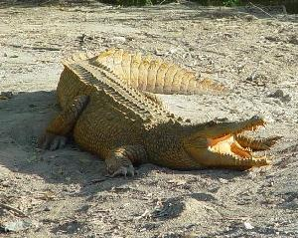
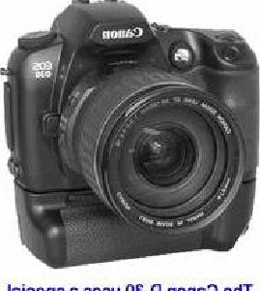
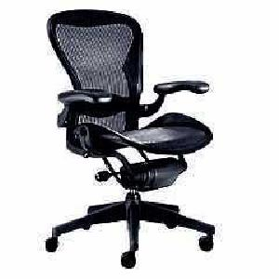
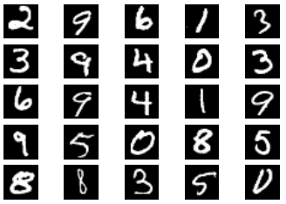
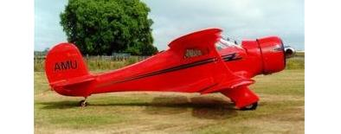
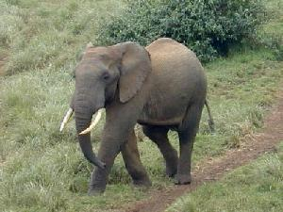
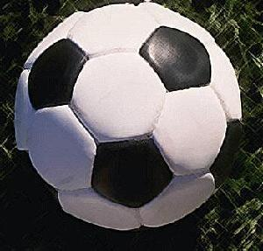
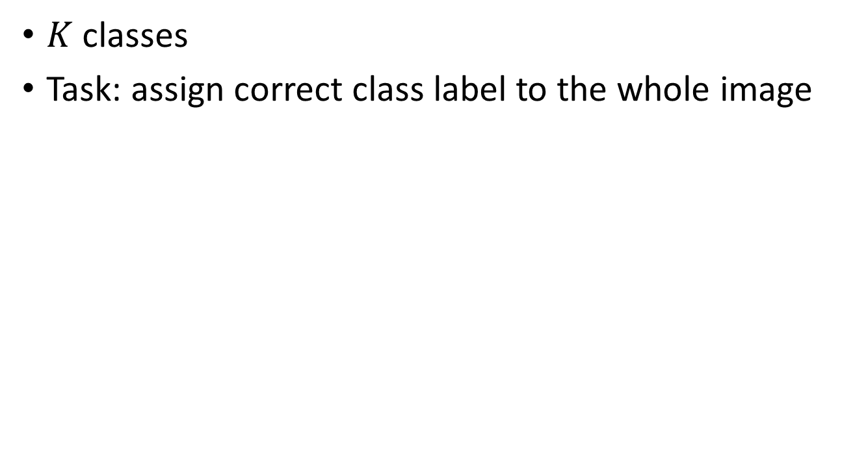
Image classification
$K$ classes
Task: assign correct class label to the whole image
Digit classification (MNIST)
Object recognition (Caltech-101)

Slide 4
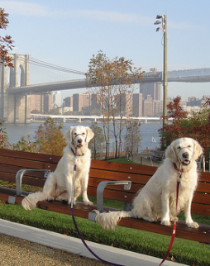
Classification vs. Detection
Dog
Dog
Dog

Slide 5
Problem formulation
{ airplane, bird, motorbike, person, sofa }
person
motorbike
Input
Desired output

Slide 6
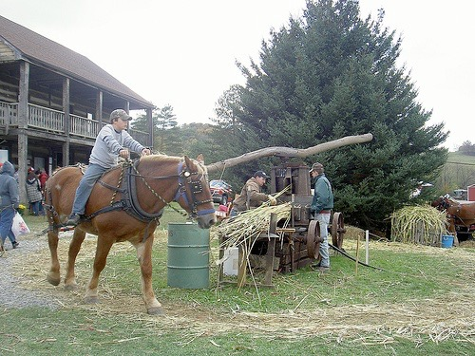
Evaluating a detector
Test image (previously unseen)

Slide 7
First detection ...
0.9
‘person’ detector predictions

Slide 8
Second detection ...
0.9
0.6
‘person’ detector predictions

Slide 9
Third detection ...
0.2
0.9
0.6
‘person’ detector predictions

Slide 10
Compare to ground truth
0.2
0.9
0.6
‘person’ detector predictions
ground truth ‘person’ boxes

Slide 11
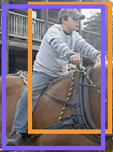
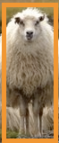

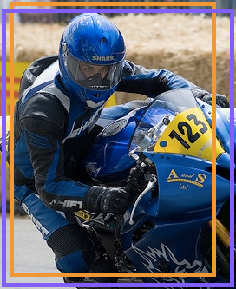
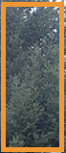
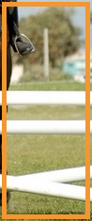
Sort by confidence
0.9
0.8
0.6
0.5
0.2
0.1
...
...
...
...
...
✓
X
✓
✓
X
X
true
positive
(high overlap)
false
positive
(no overlap,
low overlap, or
duplicate)
Notes:
Let’s define the problem a bit more so we’re all on the same page.

Slide 12
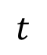
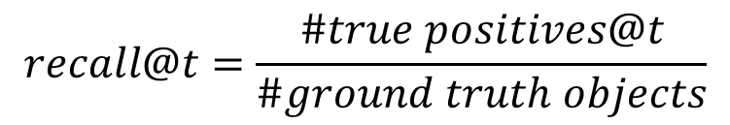
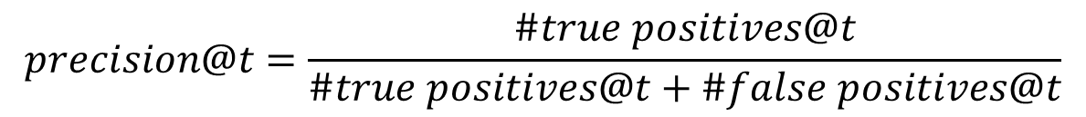
Evaluation metric
0.9
0.8
0.6
0.5
0.2
0.1
...
...
...
...
...
✓
X
✓
✓
X
X
$$t$$
$$precision@t=\frac{\#true positives@t}{\#true positives@t+\#false positives@t}$$
✓
✓ +
X
$$recall@t=\frac{\#true positives@t}{\#ground truth objects}$$
Notes:
Let’s define the problem a bit more so we’re all on the same page.

Slide 13
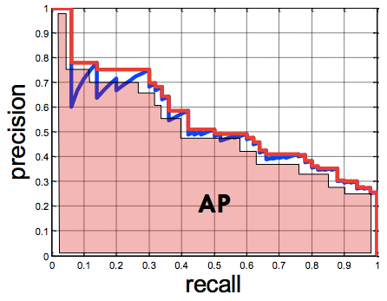
Evaluation metric
0.9
0.8
0.6
0.5
0.2
0.1
...
...
...
...
...
✓
X
✓
✓
X
X
Average Precision (AP)
0% is worst
100% is best
mean AP over classes
(mAP)
Notes:
Let’s define the problem a bit more so we’re all on the same page.

Slide 14
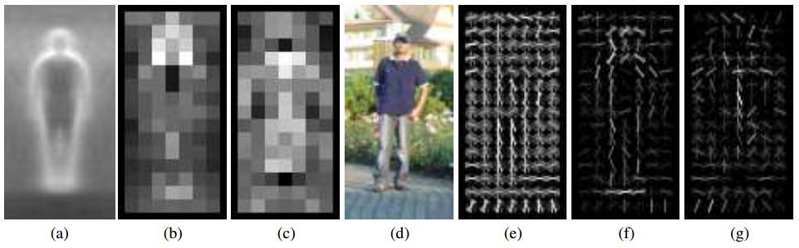
Pedestrians
Histograms of Oriented Gradients for Human Detection, Dalal and Triggs, CVPR 2005
AP ~77%
More sophisticated methods: AP ~90%
(a) average gradient image over training examples
(b) each “pixel” shows max positive SVM weight in the block centered on that pixel
(c) same as (b) for negative SVM weights
(d) test image
(e) its R-HOG descriptor
(f) R-HOG descriptor weighted by positive SVM weights
(g) R-HOG descriptor weighted by negative SVM weights

Slide 15
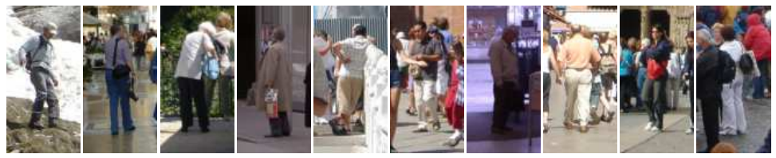
Why did it work?
Average gradient image

Slide 16
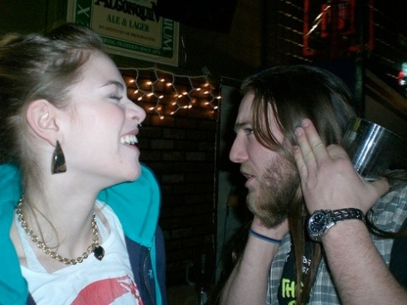
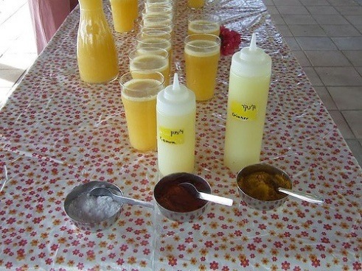
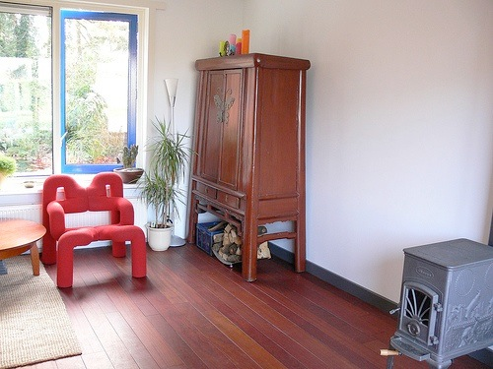
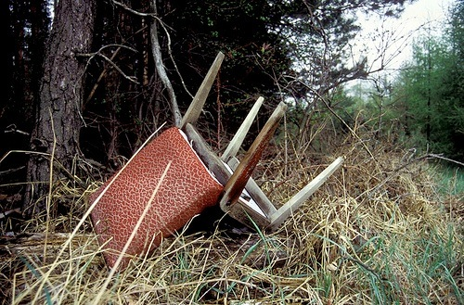
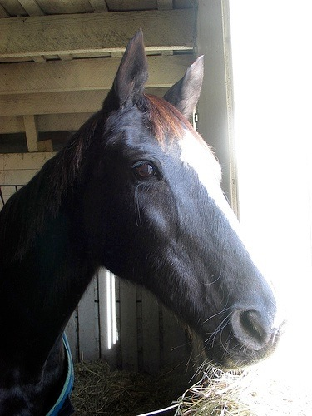
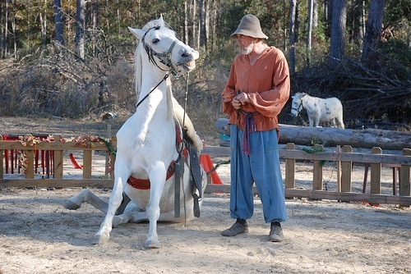
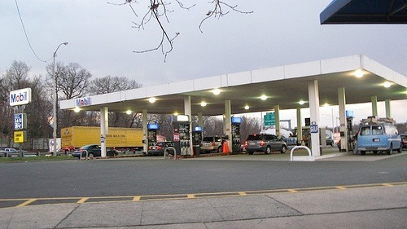
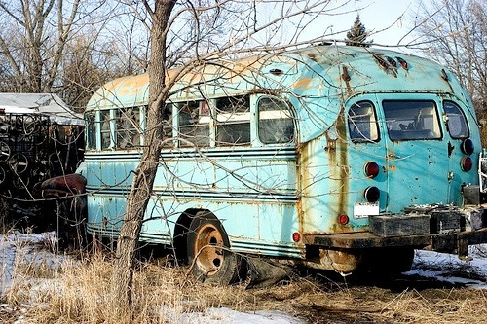
Generic categories
Can we detect people, chairs, horses, cars, dogs, buses, bottles, sheep …?
PASCAL Visual Object Categories (VOC) dataset

Slide 17
Generic categories Why doesn’t this work (as well)?
Can we detect people, chairs, horses, cars, dogs, buses, bottles, sheep …?
PASCAL Visual Object Categories (VOC) dataset

Slide 18
Quiz time

Slide 19

Warm up
This is an average image of which object class?

Slide 20
Warm up
pedestrian

Slide 21
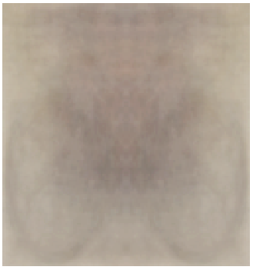
A little harder
?

Slide 22
A little harder
?
Hint: airplane, bicycle, bus, car, cat, chair, cow, dog, dining table

Slide 23
A little harder
bicycle (PASCAL)

Slide 24
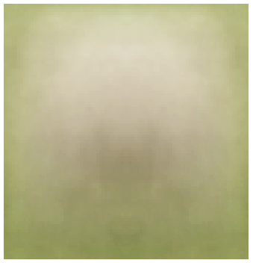
A little harder, yet
?

Slide 25
A little harder, yet
?
Hint: white blob on a green background

Slide 26
A little harder, yet
sheep (PASCAL)

Slide 27
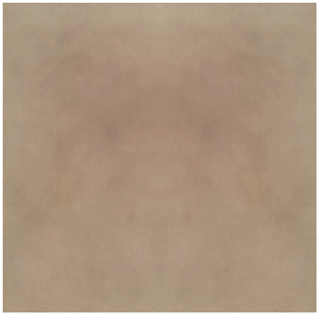
Impossible?
?

Slide 28
Impossible?
dog (PASCAL)

Slide 29
Impossible?
dog (PASCAL)
Why does the mean look like this?
There’s no alignment between the examples!
How do we combat this?

Slide 30
PASCAL VOC detection history
41%
41%
37%
DPM++,
MKL,
Selective
Search
Selective
Search,
DPM++,
MKL
28%
DPM++
23%
DPM,
MKL
17%
DPM,
HOG+
BOW
DPM

Slide 31
Part-based models & multiple features (MKL)
41%
41%
37%
rapid performance improvements
DPM++,
MKL,
Selective
Search
Selective
Search,
DPM++,
MKL
28%
DPM++
23%
DPM,
MKL
17%
DPM,
HOG+
BOW
DPM

Slide 32
Kitchen-sink approaches
increasing complexity & plateau
41%
41%
37%
DPM++,
MKL,
Selective
Search
Selective
Search,
DPM++,
MKL
28%
DPM++
23%
DPM,
MKL
17%
DPM,
HOG+
BOW
DPM

Slide 33
Region-based Convolutional Networks (R-CNNs)
62%
53%
R-CNN v2
R-CNN v1
41%
41%
37%
DPM++,
MKL,
Selective
Search
Selective
Search,
DPM++,
MKL
28%
DPM++
23%
DPM,
MKL
17%
DPM,
HOG+
BOW
DPM
[R-CNN. Girshick et al. CVPR 2014]

Slide 34
Region-based Convolutional Networks (R-CNNs)
~1 year
~5 years
[R-CNN. Girshick et al. CVPR 2014]

Slide 35
Convolutional Neural Networks
Overview

Slide 36
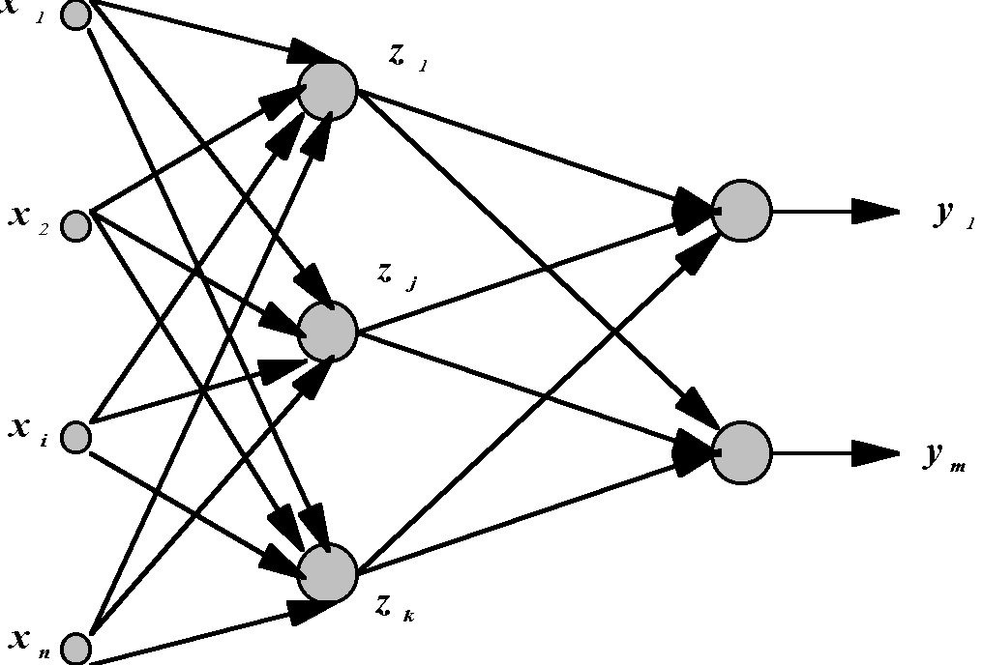
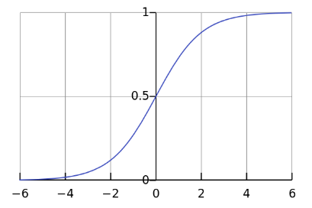
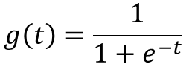
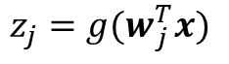
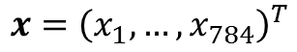
Standard Neural Networks
“Fully connected”
$$x={\left(x_{1},…,x_{784}\right)}^{T}$$
$$z_{j}={g(w}_{j }^{T}x)$$
$$g\left(t\right)=\frac{1}{1+e^{−t}}$$

Slide 37
From NNs to Convolutional NNs
Local connectivity
Shared (“tied”) weights
Multiple feature maps
Pooling

Slide 38
Convolutional NNs
Local connectivity
compare
Each green unit is only connected to (3) neighboring blue units

Slide 39
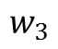
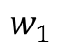
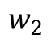
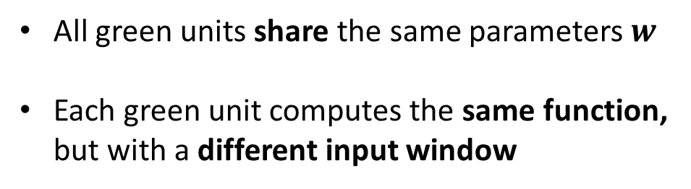
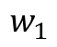
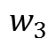
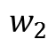
Convolutional NNs
Shared (“tied”) weights
$$w_{1}$$
$$w_{2}$$
$$w_{3}$$
All green units share the same parameters $w$
Each green unit computes the same function, but with a different input window
$$w_{1}$$
$$w_{2}$$
$$w_{3}$$

Slide 40
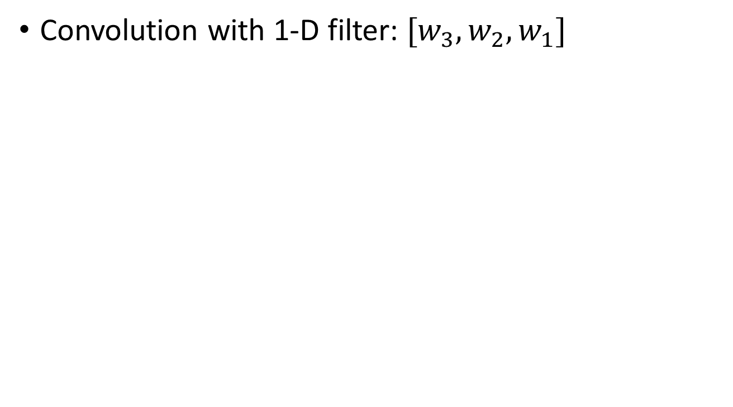
Convolutional NNs
Convolution with 1-D filter: $[w_{3},w_{2},w_{1}]$
$$w_{1}$$
$$w_{2}$$
$$w_{3}$$
All green units share the same parameters $w$
Each green unit computes the same function, but with a different input window

Slide 41
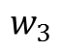
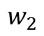
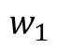
Convolutional NNs
Convolution with 1-D filter: $[w_{3},w_{2},w_{1}]$
$$w_{1}$$
$$w_{2}$$
All green units share the same parameters $w$
Each green unit computes the same function, but with a different input window
$$w_{3}$$

Slide 42
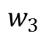
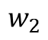

Convolutional NNs
Convolution with 1-D filter: $[w_{3},w_{2},w_{1}]$
All green units share the same parameters $w$
Each green unit computes the same function, but with a different input window
$$w_{1}$$
$$w_{2}$$
$$w_{3}$$

Slide 43



Convolutional NNs
Convolution with 1-D filter: $[w_{3},w_{2},w_{1}]$
All green units share the same parameters $w$
Each green unit computes the same function, but with a different input window
$$w_{1}$$
$$w_{2}$$
$$w_{3}$$

Slide 44



Convolutional NNs
Convolution with 1-D filter: $[w_{3},w_{2},w_{1}]$
All green units share the same parameters $w$
Each green unit computes the same function, but with a different input window
$$w_{1}$$
$$w_{2}$$
$$w_{3}$$

Slide 45



Convolutional NNs
Multiple feature maps
$${w′}_{1}$$
$${w′}_{2}$$
All orange units compute the same function but with a different input windows
Orange and green units compute different functions
$${w′}_{3}$$
$$w_{1}$$
Feature map 2
(array of orange
units)
$$w_{2}$$
$$w_{3}$$
Feature map 1
(array of green
units)

Slide 46
Convolutional NNs
Pooling (max, average)
1
4
Pooling area: 2 units
Pooling stride: 2 units
Subsamples feature maps
4
0
3
3

Slide 47



2D input
Pooling
Convolution
Image

Slide 48

1989
Backpropagation applied to handwritten zip code recognition, Lecun et al., 1989

Slide 49

Historical perspective – 1980

Slide 50

Historical perspective – 1980
Hubel and Wiesel
1962
Included basic ingredients of ConvNets, but no supervised learning algorithm

Slide 51

Supervised learning – 1986
Gradient descent training with error backpropagation
Early demonstration that error backpropagation can be used
for supervised training of neural nets (including ConvNets)

Slide 52


Supervised learning – 1986
“T” vs. “C” problem
Simple ConvNet

Slide 53

Practical ConvNets
Gradient-Based Learning Applied to Document Recognition,
Lecun et al., 1998

Slide 54
Demo
http://cs.stanford.edu/people/karpathy/convnetjs/demo/mnist.html
ConvNetJS by Andrej Karpathy (Ph.D. student at Stanford)
Software libraries
Caffe (C++, python, matlab)
Torch7 (C++, lua)
Theano (python)

Slide 55
The fall of ConvNets
The rise of Support Vector Machines (SVMs)
Mathematical advantages (theory, convex optimization)
Competitive performance on tasks such as digit classification
Neural nets became unpopular in the mid 1990s

Slide 56
The key to SVMs
It’s all about the features
HOG features
SVM weights
(+) (-)
Histograms of Oriented Gradients for Human Detection, Dalal and Triggs, CVPR 2005

Slide 57
Core idea of “deep learning”
Input: the “raw” signal (image, waveform, …)
Features: hierarchy of features is learned from the raw input

Slide 58
If SVMs killed neural nets, how did they come back (in computer vision)?

Slide 59



What’s new since the 1980s?
More layers
LeNet-3 and LeNet-5 had 3 and 5 learnable layers
Current models have 8 – 20+
“ReLU” non-linearities (Rectified Linear Unit)
$g\left(x\right)=\max\left(0, x\right)$
Gradient doesn’t vanish
“Dropout” regularization
Fast GPU implementations
More data
$$g(x)$$
$$x$$

Slide 60

Ross’s Own System: Region CNNs

Slide 61

Competitive Results

Slide 62
Top Regions for Six Object Classes

